Slide 1

HOUSING PROJECT Submitted by fenny denny

Slide 2
Introduction
Houses are one of the necessary need of each and every person around the globe and therefore housing and real estate market is one of the markets which is one of the major contributors in the world’s economy. It is a very large market and there are various companies working in the domain. Data science comes as a very important tool to solve problems in the domain to help the companies increase their overall revenue, profits, improving their marketing strategies and focusing on changing trends in house sales and purchases. Predictive modelling, Market mix modelling, recommendation systems are some of the machine learning techniques used for achieving the business goals for housing companies.

Slide 3
Problem statement
Our problem is related to one such housing company. A US-based housing company named Surprise Housing has decided to enter the Australian market. The company uses data analytics to purchase houses at a price below their actual values and flip them at a higher price. For the same purpose, the company has collected a data set from the sale of houses in Australia. The data is provided in the CSV file below. The company is looking at prospective properties to buy houses to enter the market. You are required to build a model using Machine Learning in order to predict the actual value of the prospective properties and decide whether to invest in them or not.
For this company wants to know:
• Which variables are important to predict the price of variable?
• How do these variables describe the price of the house?

Slide 4
Analytical Problem Framing
As from the Problem statement we can understand that this Dataset needs Advanced Regression for Model Building.
We will be using some regressor algorithms to try and find the Best Model for our Dataset.
As from the Dataset we have seen that it is highly filled with impurities, for that we have to do feature engineering and extensive Data Cleaning.

Slide 5
Data Sources & Formats
The Dataset is in a .csv (comma separated value).
The general information about the dataset is given in a documentation format.
Information about the dependent and independent variables are given in an Excel Format.

Slide 6
Data Pre-processing
Data pre-processing is a data mining technique that involves transforming raw data into an understandable format. Real-world data is often incomplete, inconsistent, lacking in certain behaviours or trends, and is likely to contain many errors.
Data pre-processing is a proven method of resolving such issues. Data pre-processing prepares raw data for further processing. Data pre-processing is used in database-driven applications such as customer relationship management and rule-based applications (like neural networks).
In Machine Learning (ML) processes, data pre-processing is critical to encode the dataset in a form that could be interpreted and parsed by the algorithm.

Slide 7
So now we have established what is Data pre-processing, I will let know all the steps I took to clean the Data before proceeding
- Firstly I checked for Null Values, there were so we will treat them later.
- Secondly I checked for any Nan values in the dataset which I found, so I filled all the Nan values with zero rather than removing it.
- Thirdly I found outliers and skewness in the Dataset which I dealt with by using median of the columns and replacing it with respective medians.
- I also found some ‘-‘sign in the dataset. Which I removed with the help of replace statement.

Slide 8
Assumptions
As from the Problem statement which states that we have to build a model which will predict average price. Since the target variable is continuous we can readily presume that it is a Regression Problem for which we will be using Regressor algorithms to build our model from the dataset given.
Secondly as we know Data is very expensive I tried those methods for Data cleaning which doesn’t require removal of bulk of Data.
Like for example I did not use IQR method for Outliers as it would have erased huge amounts of Data. Instead I used Median method for Outlier treatment.
Lastly I will be using RandomSearch CV for hyper parameter tuning as it uses least amount of memory and processing power to run the algorithms as compared to that of GridSearch CV.

Slide 9
Identification of Possible Problem Solving approaches
There are null values in the dataset.
Dataset is skewed, we have to perform feature engineering
For some features, there may be values which might not be realistic.
I also came across outliers in some features

Slide 10
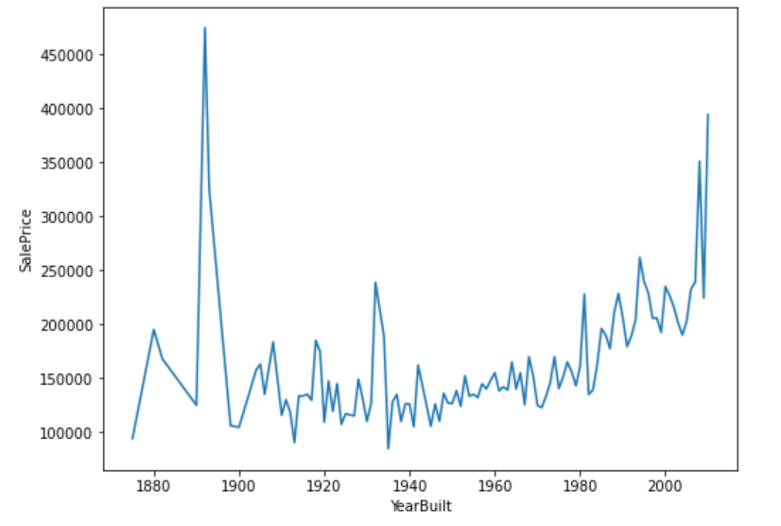
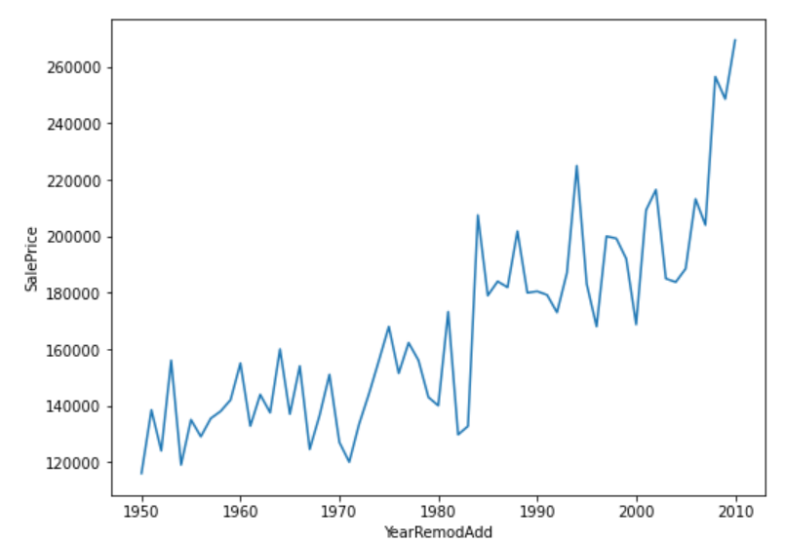
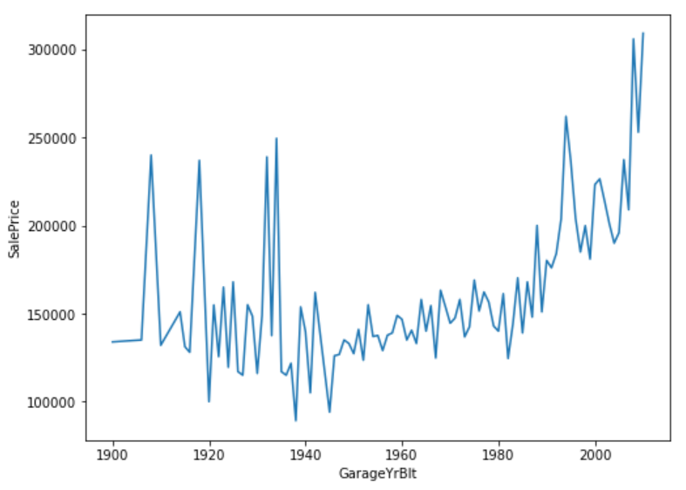
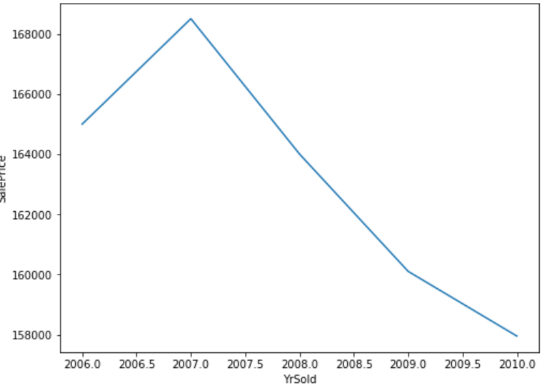
EDA

Slide 11
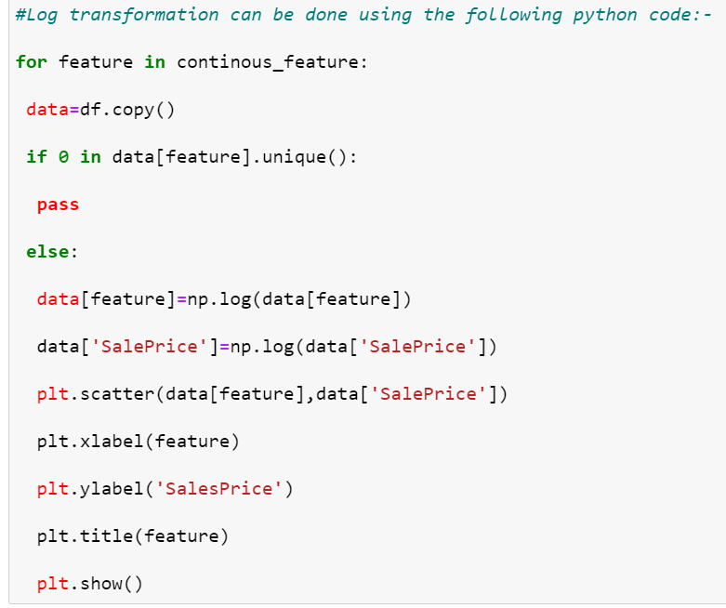
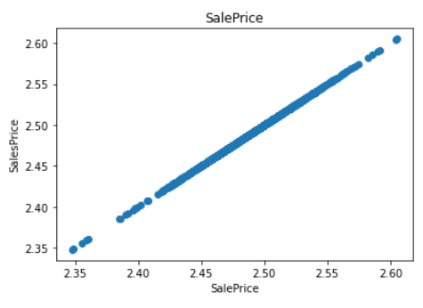
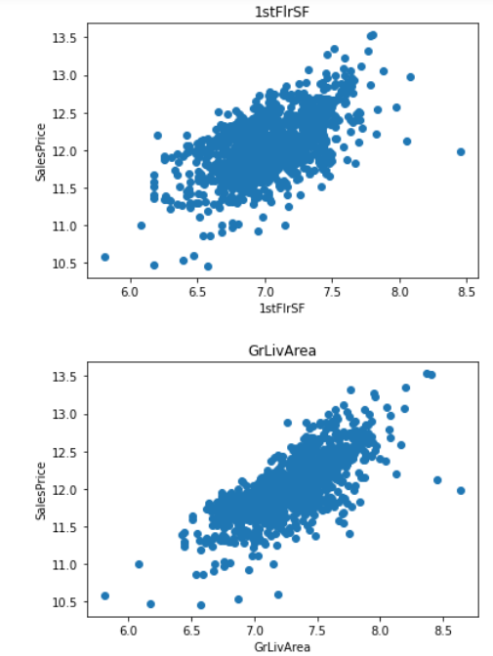
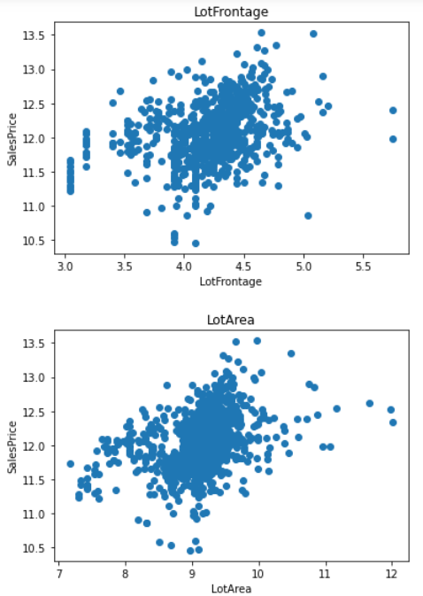

Slide 12
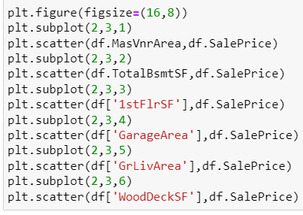
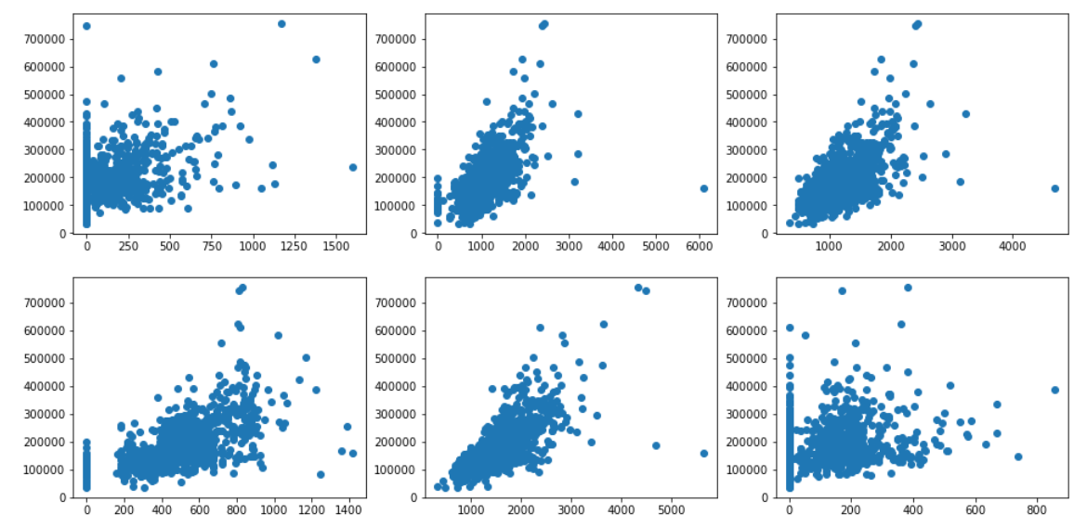

Slide 13
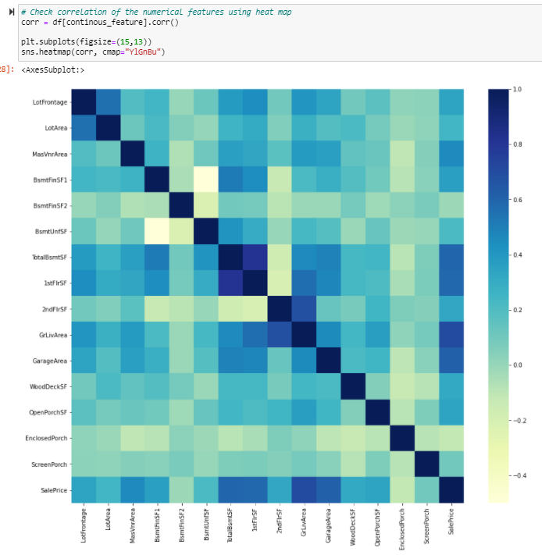

Slide 14
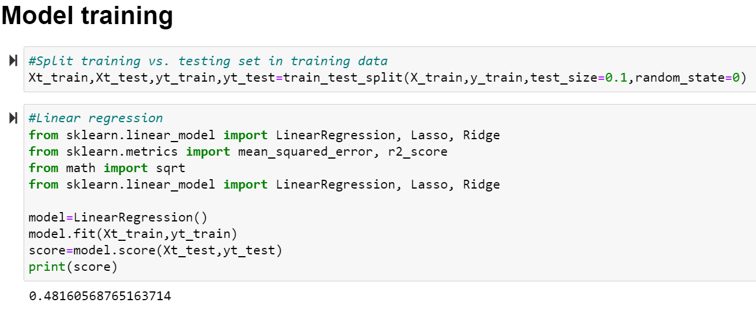
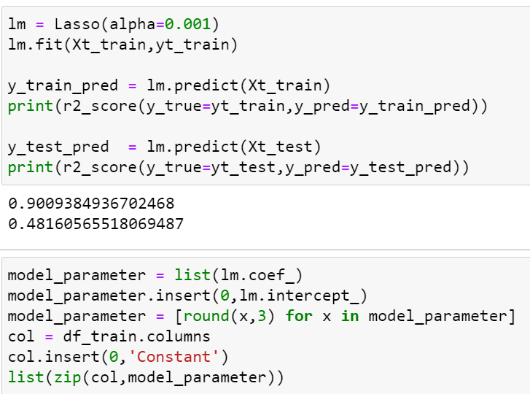
Model Building

Slide 15
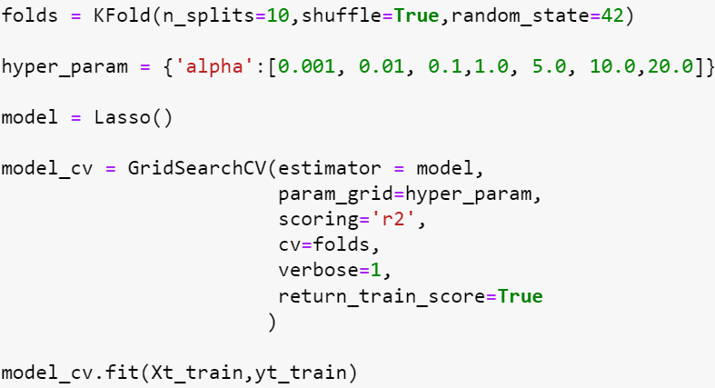
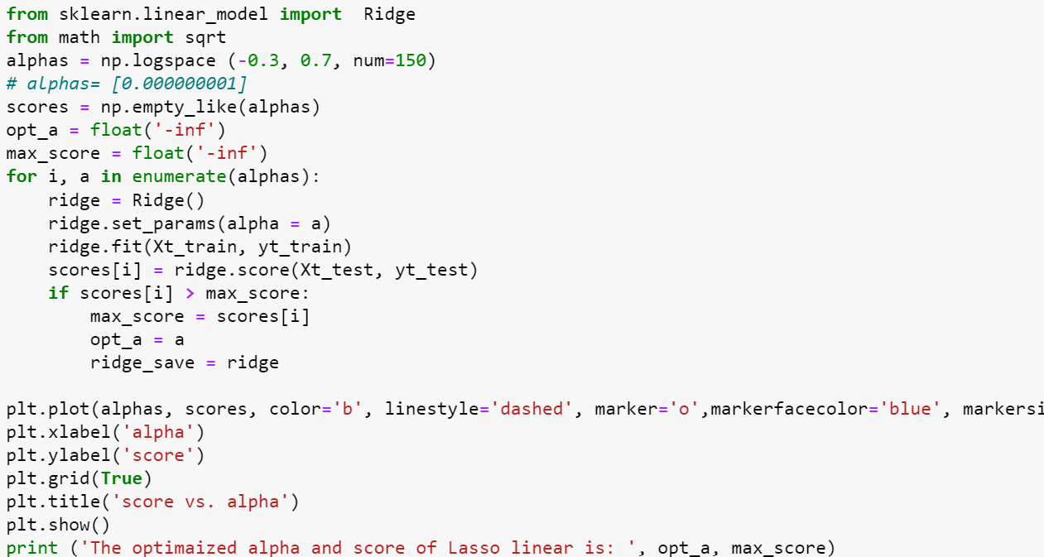
GridSearch Cv Lasso

Slide 16
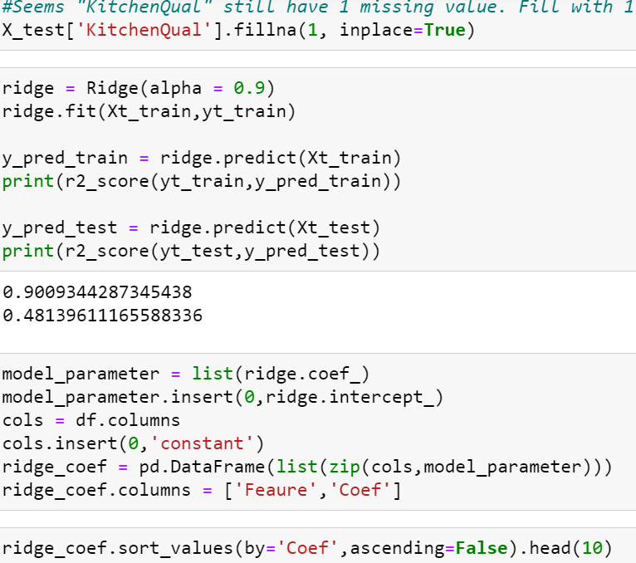

Slide 17
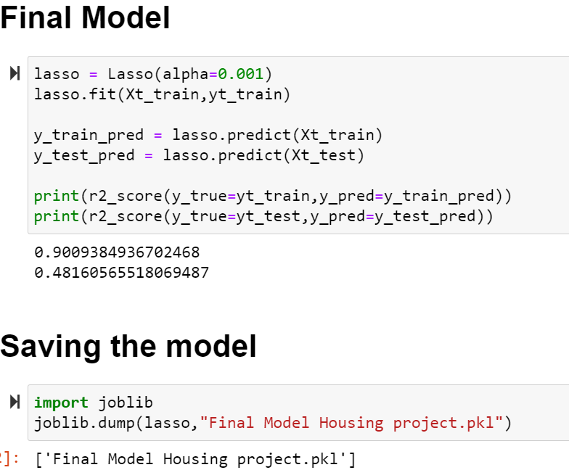

Slide 18
Conclusion
After comparing both the model we can see that the below Features are best explaining the Dataset
From this project I draw these following conclusions:
MiscVal : $Value of miscellaneous feature .
BsmtHalfBath : Basement half bathrooms.
LowQualFinSF : Low quality finished square feet (all floors).
BsmtFullBath : Basement full bathrooms.
HalfBath : Half baths above grade.

Slide 19
We have walked through setting up basic simple linear and multiple linear regression models to predict housing prices resulting from macroeconomic forces and how to assess the quality of a linear regression model on a basic level.
To be sure, explaining housing prices is a difficult problem. There are many more predictor variables that could be used. And causality could run the other way; that is, housing prices could be driving our macroeconomic variables; and even more complex still, these variables could be influencing each other simultaneously.

Slide 20


